Slide 1
Automotive Trends-Data Analysis-PYTHON
Mentor name : Lopamudra Bera
Leaners name: Manju Thomas

Slide 2
Objectives
The objective of the project is to analyse a car dataset to gain insights into popular trends and identify key factors for launching promising car models.
Extract actionable insights from the given data, addressing key areas such as categorizing cars based on market segmentation, conducting fuel efficiency analysis, comparing performance, studying weight distribution, assessing safety features, exploring user comfort, analysing alert systems, and conducting dimensional analysis.

Slide 3
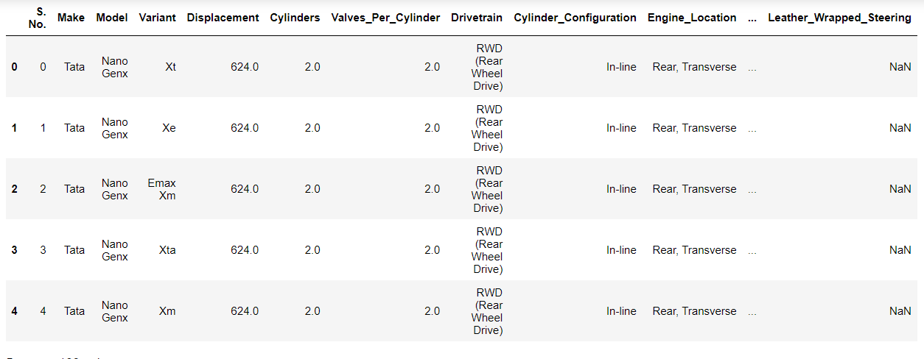
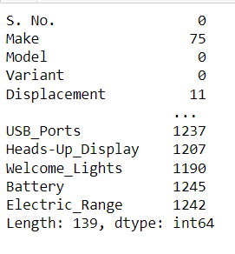

Level 0 and level 1 Analysis
Observe many columns with null values. I treated selected numerical columns with mean by Make and Model.Categorical columns with ‘0’.Treating a number of columns with mean and mode may affect the accuracy of analysis.

Slide 4
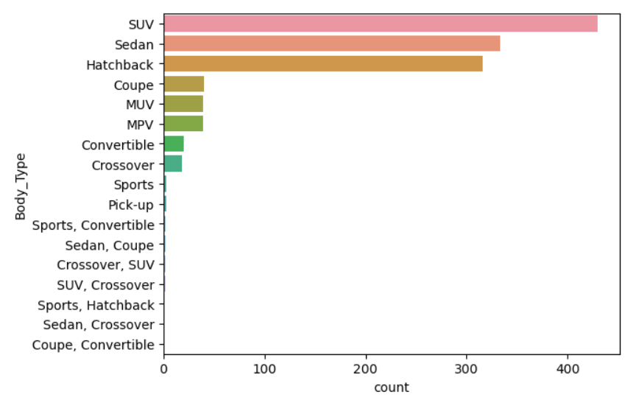
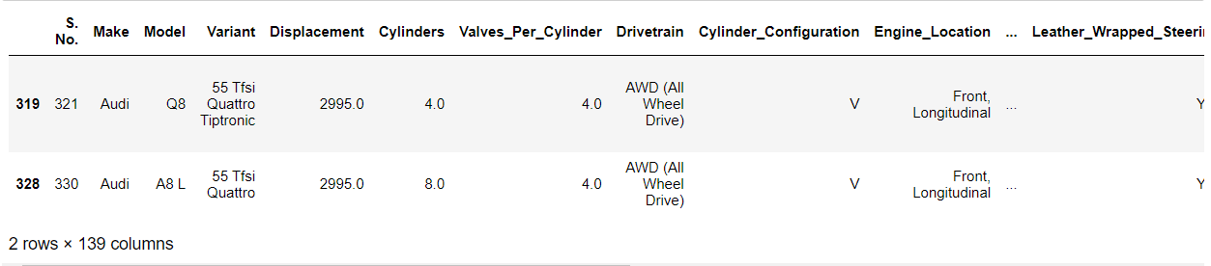
Market Segmentation Analysis
Task 1: A new car manufacturer wants to introduce a new car and wants information about the top 5 most preferred car body types. Display the result using a horizontal bar chart.
Task 2: List all the details of cars that can adapt to various driving conditions such as normal, comfort, eco, sport, and power mode. How many cars have all the above-mentioned features?
INTERPRETATION :As per the above graph "SUV,Sedan and hatchback are the" most preferred body type among users.
INTERPRETATION: 2 cars are listed out with all other details of different driving modes

Slide 5
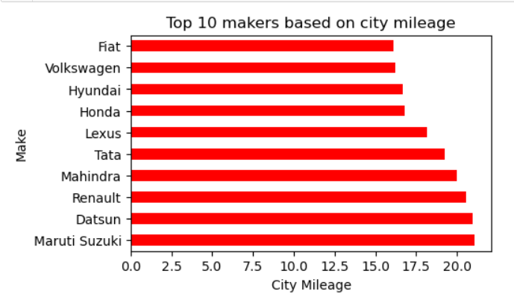
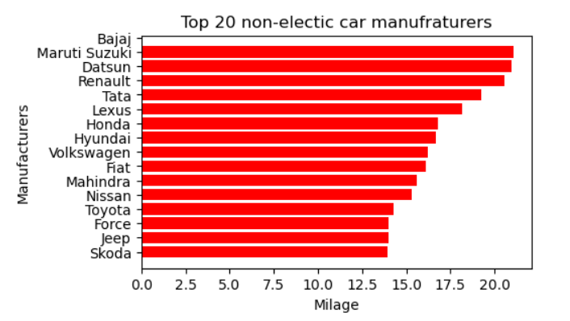
Fuel Efficiency Analysis
Task 3: Identify the top 10 car manufacturers based on the city mileage and display the result using a horizontal bar graph with the manufacturer on the y-axis and mileage on the x-axis. Do you notice any outliers in the above output? If yes, what is the reason, and how would you resolve it?
Task 4: Identify the top 20 non-electric car manufacturers based on city mileage and display the results using a bar graph similar to that in task 1.
INTERPRETATION:
Top 10 car manufacturers based on city mileage in market are listed in above graph, when compare to other Renault,Mahindra,Maruti and Datsun are the Manufacturers which have high mileage .
INTERPRETATION : Above graph show us that Manufactures with non-electrical car in market, when compare to other Renault,Maruti,Datsun are the Manufacturer which have high mileage .

Slide 6
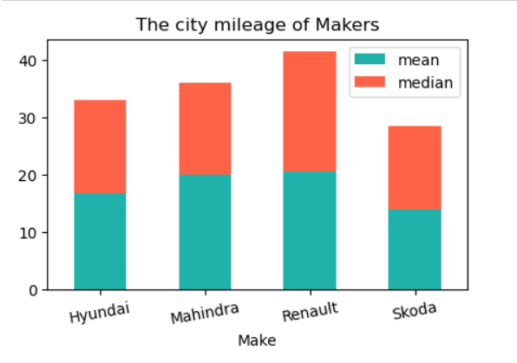
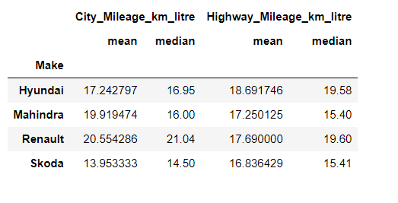
Fuel Efficiency Analysis
Task 5: Display the car mileages for the following four companies using a pivot table: Hyundai, Mahindra, Renault, and Skoda Create 4 separate pivot tables capturing the following details:
1. Mean of city mileage
2. Median of city mileage
3. Mean of highway mileage
4. Median of highway mileage
Task 6: Display the mean and median values of city mileages of the following manufacturers, using a stacked column chart: Hyundai, Renault, Mahindra, and Skoda
INTERPRETATION:
From the table we can observe that Renault and Hyundai is giving good mileage on city.
INTERPRETATION :
From the Above Stacked bar chart Renault and Mahindra gives good Mileage in city and High-way as well.

Slide 7
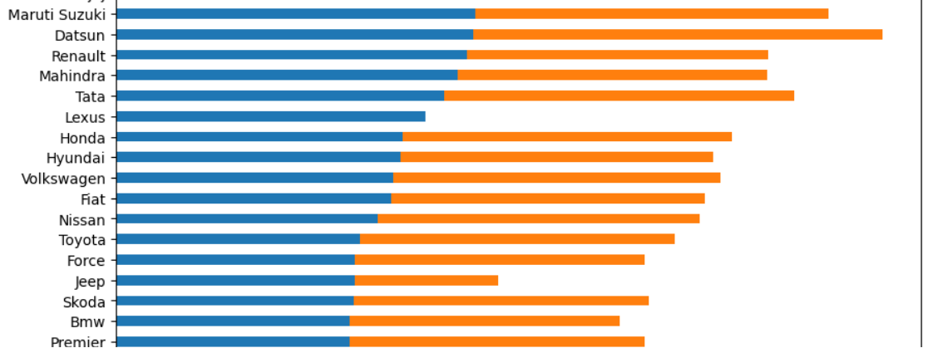
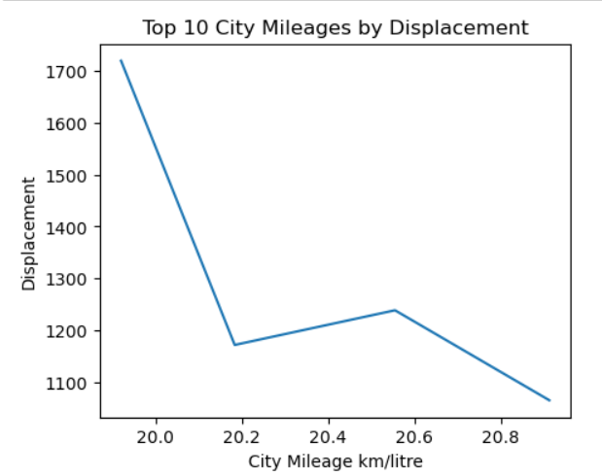

Fuel Efficiency Analysis
Task 7 :Display the average mileage (city and highway) of all manufactures using a horizontal bar chart, in ascending order of mileage.
Task 8 :Plot a line chart to understand the relation between displacement and city mileage by choosing the top 10 cars with the highest city mileage.
INTEPRETATION:
1.'Renault,Mahindra and Maruti have the highest city mileage and 'Datsun an Tata have the highest highway mirage.
2.As per the above graph 'Lamborghini' has the lowest city mileage and 'Bentley' has the lowest highway mileage.
INTERPRETATION: As per the graph displacement is inversely proportional to mileage

Slide 8
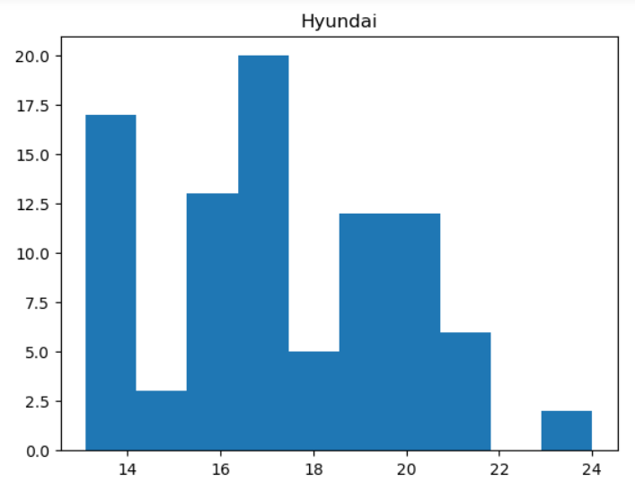
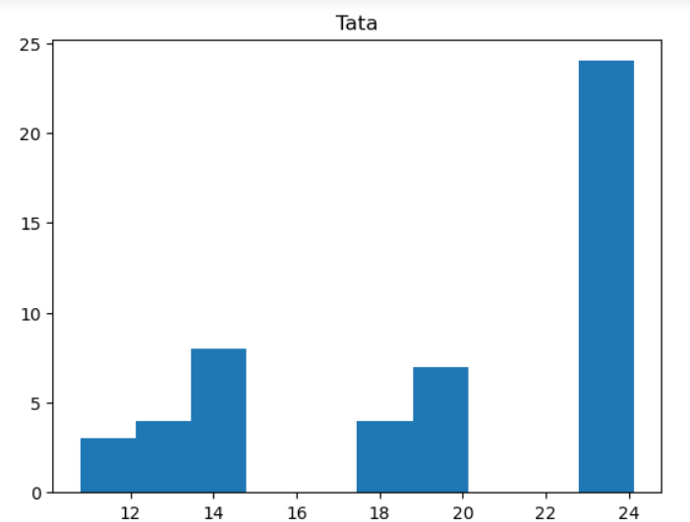
Fuel Efficiency Analysis
Task 9 :Analyze the spread of fuel economy using a histogram for all car models of the following manufacturers: Hyundai, Suzuki, Tata, and BMW
INTERPRETATION
As per the histogram Hyundai is positively skewed Maruthi Suzuki and Tata are negatively skewed.Bmw is showing no skewness. Hyundai and Tata is showing most skewed mileage distribution.

Slide 9
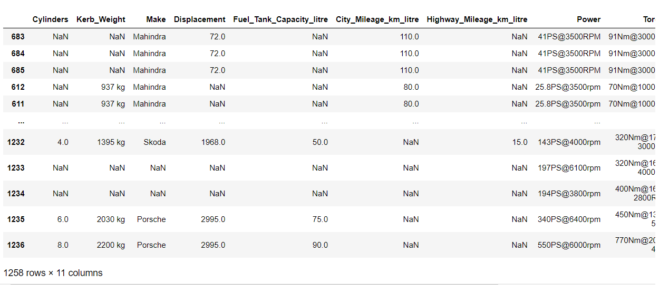
PART-2 Performance comparison analysis
Task 1: Create another data frame that includes only the following columns from the data. Perform missing value treatment for these columns, if required.
• Valves_Per_Cylinder
• Kerb_Weight
• Make
• Displacement
• Fuel_Tank_Capacity_litre
• City_Mileage_km_litre
• Highway_Mileage_km_litre
• Power
• Torque
• Gross_Vehicle_Weight

Slide 10
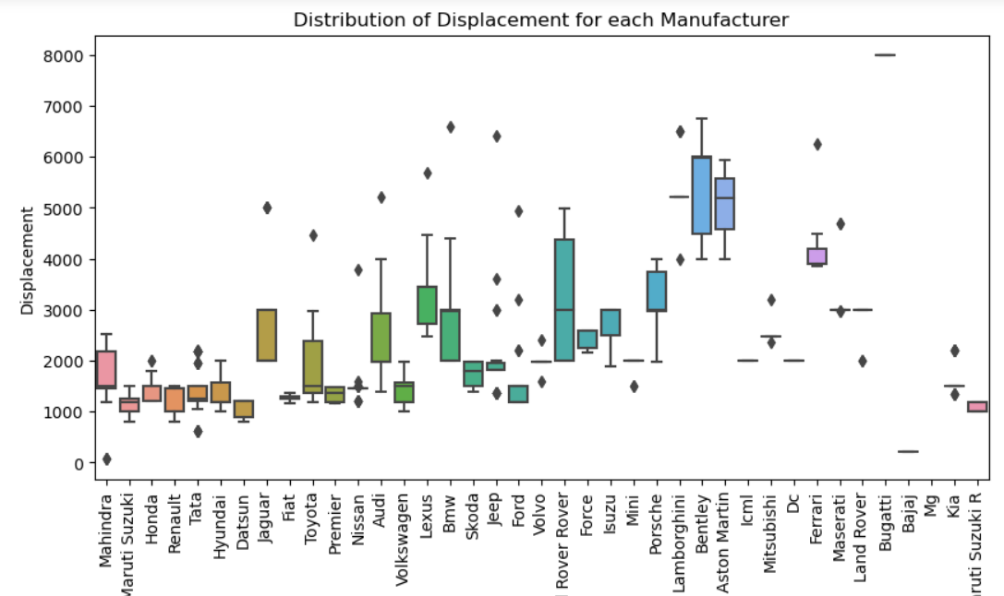
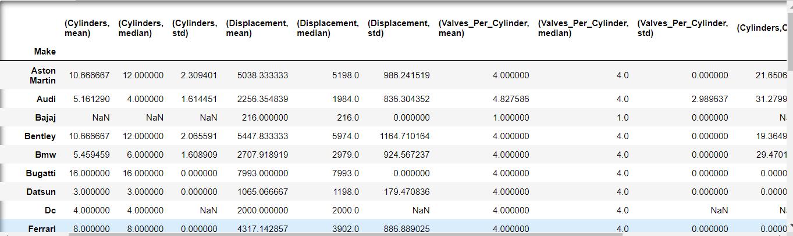
Performance Comparison
Task 3 Compare the performance of cars based on factors such as displacement, cylinders, and valves per cylinder, providing valuable insights for marketing and product development. Hint: Calculate and display the mean, median, standard deviation, and coefficient of variation for each manufacturer.
INTERPRETATION:
Observe two type of displacement in make 500-3000 and 1500-6000.

Slide 11
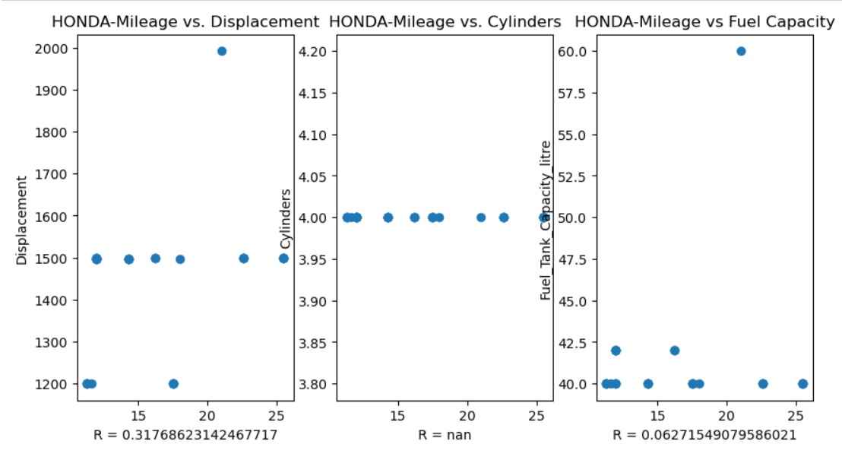
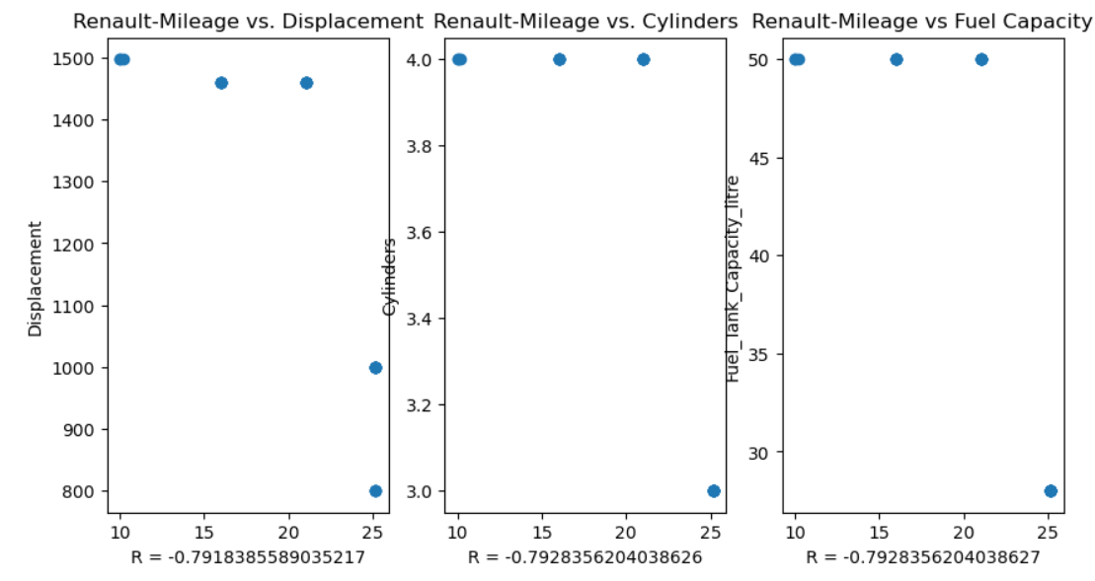
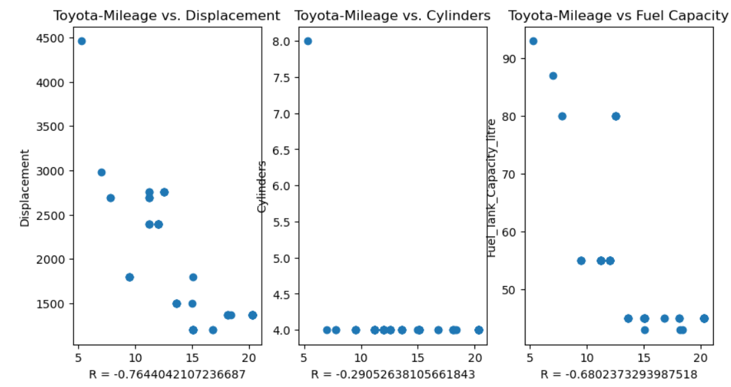
Performance Comparison
Task 4 Identify at least three features that affect the mileages (using correlation analysis) of cars from the following As per the scatter plots-fuel tank capacity vs mileage is having s: Renault, Toyota, and Honda
INTERPRETATION:HONDA
As per the scatter plots-fuel tank capacity vs mileage is having positive correlation, displacement vs mileage is having positive correlation and cylinders vs mileage is having positive correlation.
INTERPRETATION:RENAULT
As per the scatter plots-fuel tank capacity vs mileage is having negative correlation, displacement vs mileage is having negative correlation and cylinders vs mileage is also having negative correlation.
INTERPRETATION:TOYOTA
As per the scatter plots-fuel tank capacity vs mileage is having negative correlation, displacement vs mileage is having negative correlation and cylinders vs mileage is also having negative correlation.

Slide 12
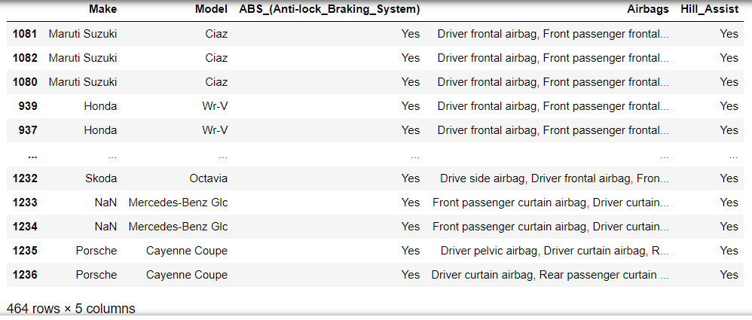
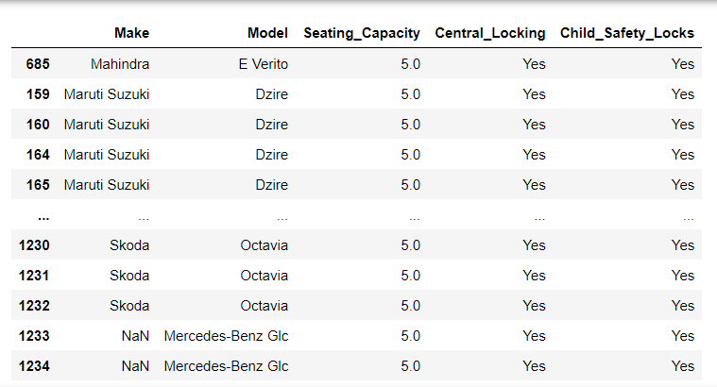
Safety Feature Assessment& User Comfort Exploration
Task 1 :Examine the presence of safety features such as ABS, airbags, and hill assist, to assess the safety standards of various car models.
Task 2 :Explore seating capacity, central locking, and child safety locks to understand user comfort and family-friendly features
INTERPRETATION:
472 cars are listed with safety features like ABS, Airbags and Hill assist.
INTERPRETATION:
There are 992 such cars with seating capacity more than mean(5) ,central locking and child safety locks like family friendly features

Slide 13
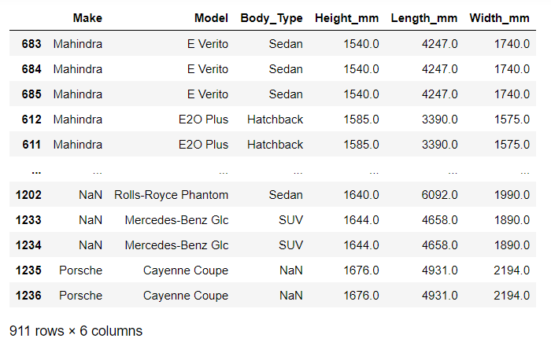
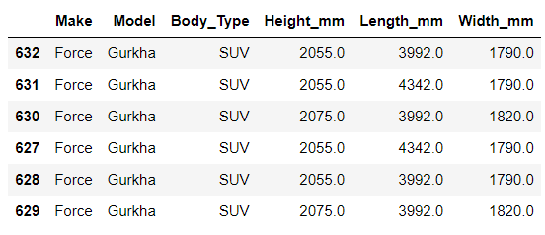
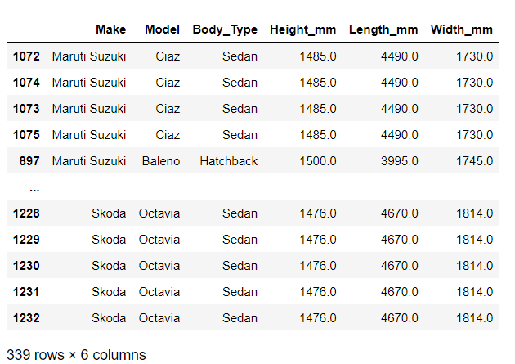
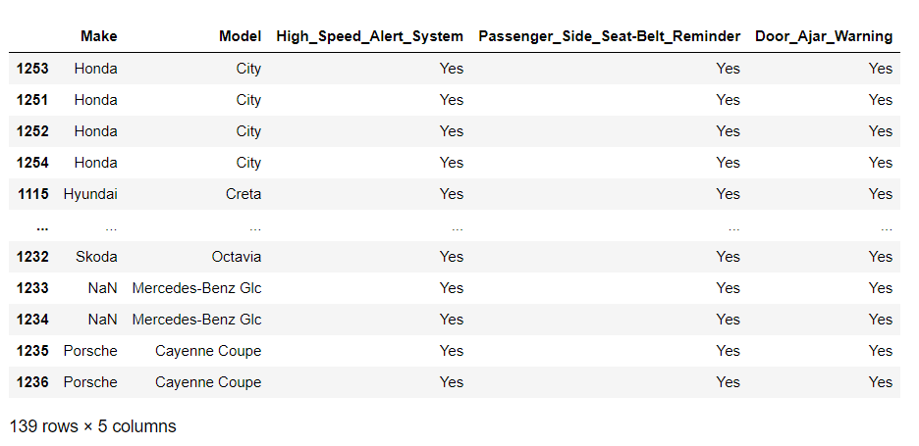
Alert Systems Analysis & Dimensional Analysis
Task 3 Investigate the presence of high-speed alerts, seat belt reminders, and door ajar warnings to assess the integration of safety and convenience features.
Task 4 Analyze the dimensions of cars (height, length, width) to understand size preferences and market demands, aiding in product planning.
INTERPRETATION:
We can categories the vehicle into three on the basis of length length<=1500: there are 339 cars from different makers with different body types length between 1500 and 2000:There are 911 cars are from different makers with different body types length between 2000 and 2600:There are only 6 cars from Force.

Slide 14
INTERPRETATION
Market Segmentation Analysis
SUV,Sedan and hatchback are the most preferred body type among users.
Top 10 car manufacturers based on city mileage in market, when compare to other Renault,Hyundai,Mahindra,Maruti,Tata, Datsun,Volkswagen are the Manufacturers which have high mileage .
Renault ,Mahindra and Maruti Suzuki have the highest city mileage and Datsun and Tata have the highest highway mileage.
Performance Comparison
displacement is inversely proportional to mileage
Observe two type of displacement in make 500-3000 and 1500-6000.
Safety Feature Assessment& User Comfort Exploration
472 cars are listed with safety features like ABS, Airbags and Hill assist. Renault,Hyundai,Mahindra,Maruti,Tata, Datsun,Volkswagen are with top makers.
There are 992 such cars with seating capacity more than mean(5) ,central locking and child safety locks like family friendly features. Renault,Hyundai,Mahindra,Maruti,Tata, Datsun,Volkswagen are with top makers.
Alert Systems Analysis & Dimensional Analysis
140 cars with high speed alert, passenger seat belt reminder and door ajar warning. Renault,Hyundai,Mahindra,Maruti,Tata, Datsun,Volkswagen are with top makers.
We can categories the vehicle into three on the basis of length length<=1500: there are 339 cars from different makers with different body types length between 1500 and 2000:There are 911 cars are from different makers with different body types length between 2000 and 2600:There are only 6 cars from Force.

Slide 15
SUMMARY & CONCLUSION
People are using different types of car for different purposes. Individuals or families use cars to travel for happy occasions, business purposes, and emergencies. There are many factors, that's decide the future of a car model from different car manufacturers. It depends on the users of car and their preferences like body type of a car, mileage, displacement and safety and comfort features.
Renault, Mahindra, Datsun,Tata,Maruti Suzuki, Honda,Skoda,Toyota and Volkswagen are the top among the car makers can guarantee most of the features in their model up to the mark for the common users.

